Slide 1
CARSS/SPARC DRC Dissemination Plan
06/14/2023

Slide 2
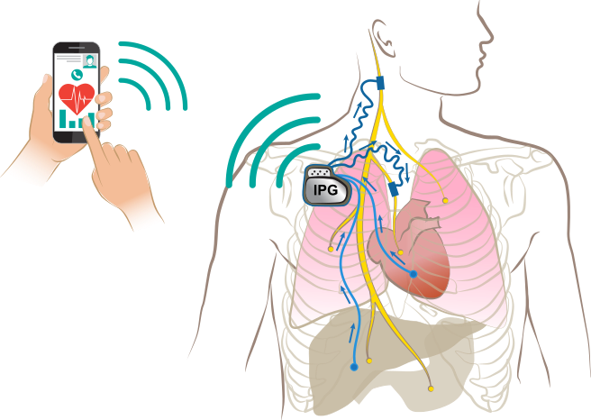
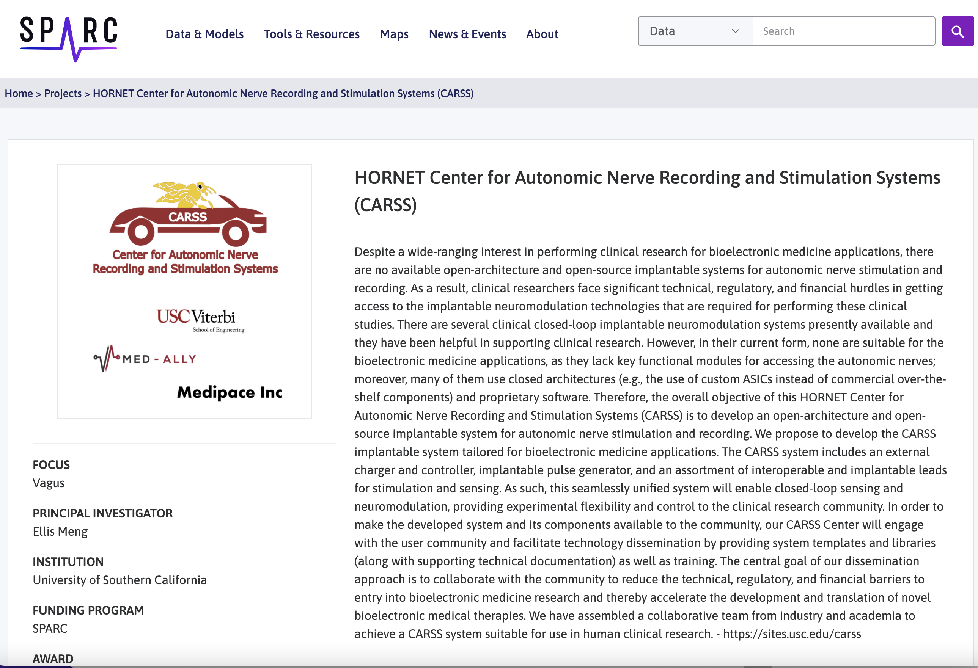
CARSS Goals
Open-source hardware and software implantable neuromodulation system to support diverse clinical needs
Overview of CARSS Neuromodulation System
CARSS SPARC DRC Portal

Slide 3
Milestones/Deliverables
Year 1
Set-up website, Wiki, Github, and SPARC DRC portal
Release initial design files, integration plan, and example user needs
Year 2
Release integration blueprint
Release in vitro verification and in vivo validation test protocol and meta data
Year 3
Complete documentation release including final design along with design files

Slide 4
File Formats to be Release
PDF, text (code, Readme), spreadsheet (data, BOM…), video (protocol), image (jpeg…)
Unique files uploaded as zip to Github for manufacturing a part
STEP and dxf for mechanical parts
G-code for 3D printing
Altium Designer output files for PCB designs
Instructional README files

Slide 5
Questions for DRC
How to connect all projects that use the CARSS device in a searchable format?
Does DRC have outreach plan for clinical societies
Liver, kidney, lungs, heart, GI

